Slide 1
CS 484
Introduction to Machine Learning
Week 2, January 28, 2021
Spring Semester 2021

Slide 2
Week 2: Nearest Neighbors
Overview Memory-Based Learner
Choose Appropriate Distance Metric
Determine Optimal Number of Neighbors
Chapter 2 of the Machine Learning book

Slide 3
Memory-Based Learning (MBL) in Law
Stare decisis
Stare means stand by and decisis means decision. So, stare decisis means to stand by decision or let the decision stand.
Stare decisis is a legal doctrine that obligates courts to follow historical cases when making a ruling on a similar case.
Stare decisis ensures that cases with similar scenarios and facts are approached in the same way. Simply put, it binds courts to follow legal precedents set by previous decisions..

Slide 4
Memory-Based Learning (MBL) in Law
Legal Precedents:
Precedent refers to a court decision that is considered as authority for deciding subsequent cases involving identical or similar facts, or similar legal issues.
Precedent ensures that individuals in similar situations are treated by judges alike instead of based on a particular judge’s personal views.
Precedent is generally established by a series of decisions. Sometimes, a single decision can create precedent.

Slide 5
Memory-Based Learning (MBL)
You encounter a problem
You remembered how you solved similar problems before
You decide to apply the previous solutions to the current problem
If the solution does solve the current problem, you remember it
A memorization technique based on similarity
Use a definition of similarity
Find a fixed number of similar situations
Sum up the outcomes of these similar situation
The summary of the outcomes is the decision

Slide 6
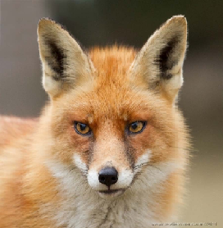

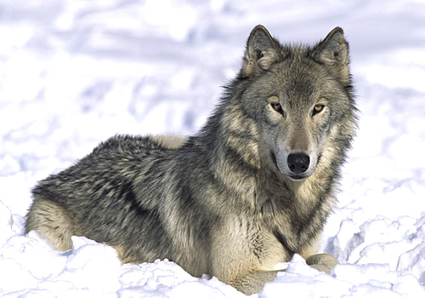
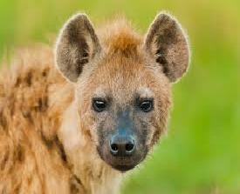
Basic Idea of the Nearest Neighbors Algorithm
If a creature walks like a dog, looks like a dog, sits like a dog, and eats like a dog then it is probably a dog.
Well, it may not bark and be obedient as a dog.
Fox
Dog
Wolf
Hyena

Slide 7
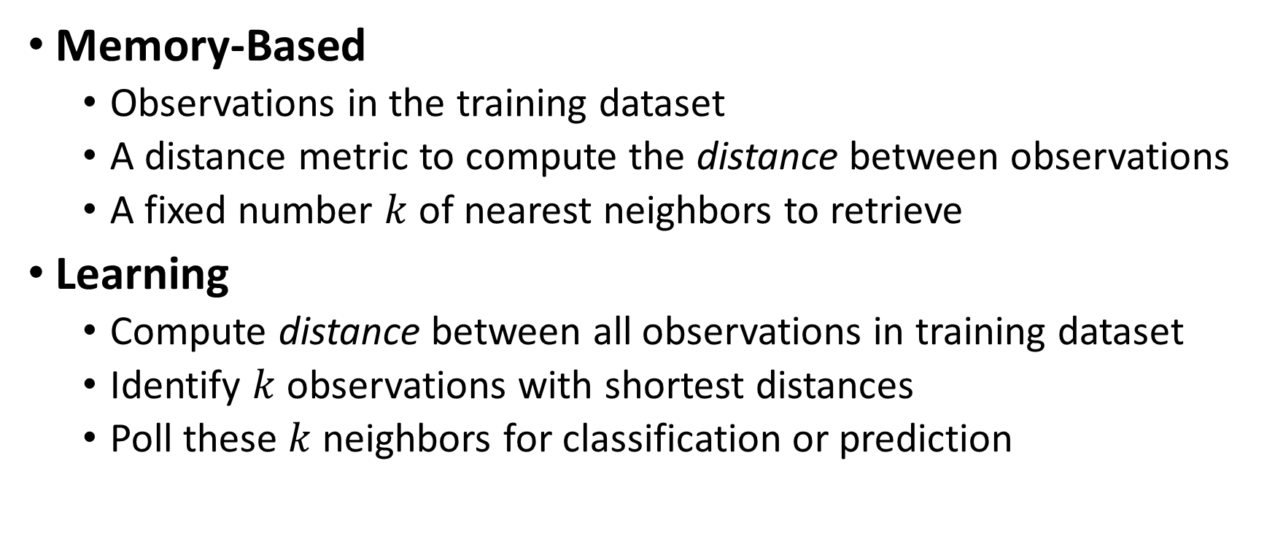
k-Nearest Neighbors (kNN) Algorithm
Memory-Based
Observations in the training dataset
A distance metric to compute the distance between observations
A fixed number $k$ of nearest neighbors to retrieve
Learning
Compute distance between all observations in training dataset
Identify $k$ observations with shortest distances
Poll these $k$ neighbors for classification or prediction

Slide 8
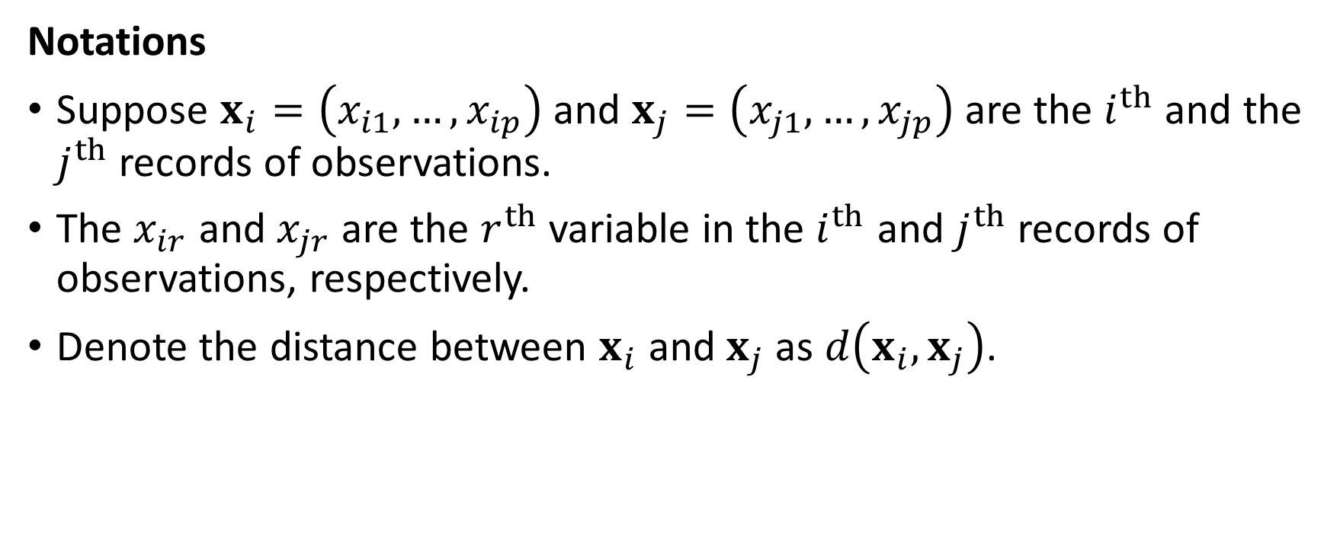
Distance Metric
Notations
Suppose $x_{i}=\left(x_{i1},…,x_{ip}\right)$ and $x_{j}=\left(x_{j1},…,x_{jp}\right)$ are the $i^{th}$ and the $j^{th}$records of observations.
The $x_{ir}$ and $x_{jr}$ are the $r^{th}$ variable in the $i^{th}$ and $j^{th}$records of observations, respectively.
Denote the distance between $x_{i}$ and $x_{j}$ as $d\left(x_{i},x_{j}\right)$.

Slide 9
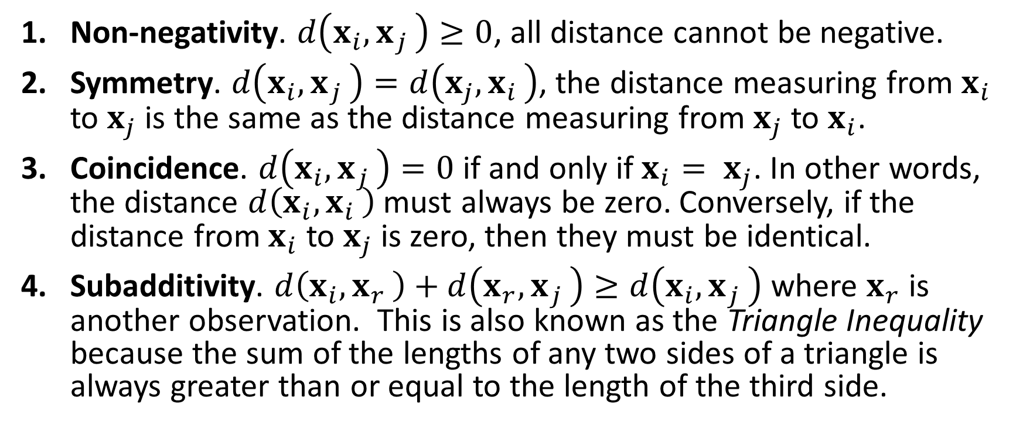
Four Requirements for Distance Metric
Non-negativity. $d\left(x_{i}{, x}_{j}\right)≥0$, all distance cannot be negative.
Symmetry. $d\left(x_{i}{, x}_{j}\right)=d\left(x_{j}{, x}_{i}\right)$, the distance measuring from $x_{i}$ to $x_{j}$ is the same as the distance measuring from $x_{j}$ to $x_{i}$.
Coincidence. $d\left(x_{i}{, x}_{j}\right)=0$ if and only if $x_{i}{= x}_{j}$. In other words, the distance $d\left(x_{i}{, x}_{i}\right)$ must always be zero. Conversely, if the distance from $x_{i}$ to $x_{j}$ is zero, then they must be identical.
Subadditivity. $d\left(x_{i}{, x}_{r}\right)+d\left(x_{r}{, x}_{j}\right)≥d\left(x_{i}{, x}_{j}\right)$ where $x_{r}$ is another observation. This is also known as the Triangle Inequality because the sum of the lengths of any two sides of a triangle is always greater than or equal to the length of the third side.

Slide 10
Common Distance Metrics
Euclidean
Manhattan
Chebyshev
Cosine

Slide 11
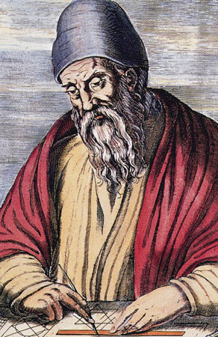
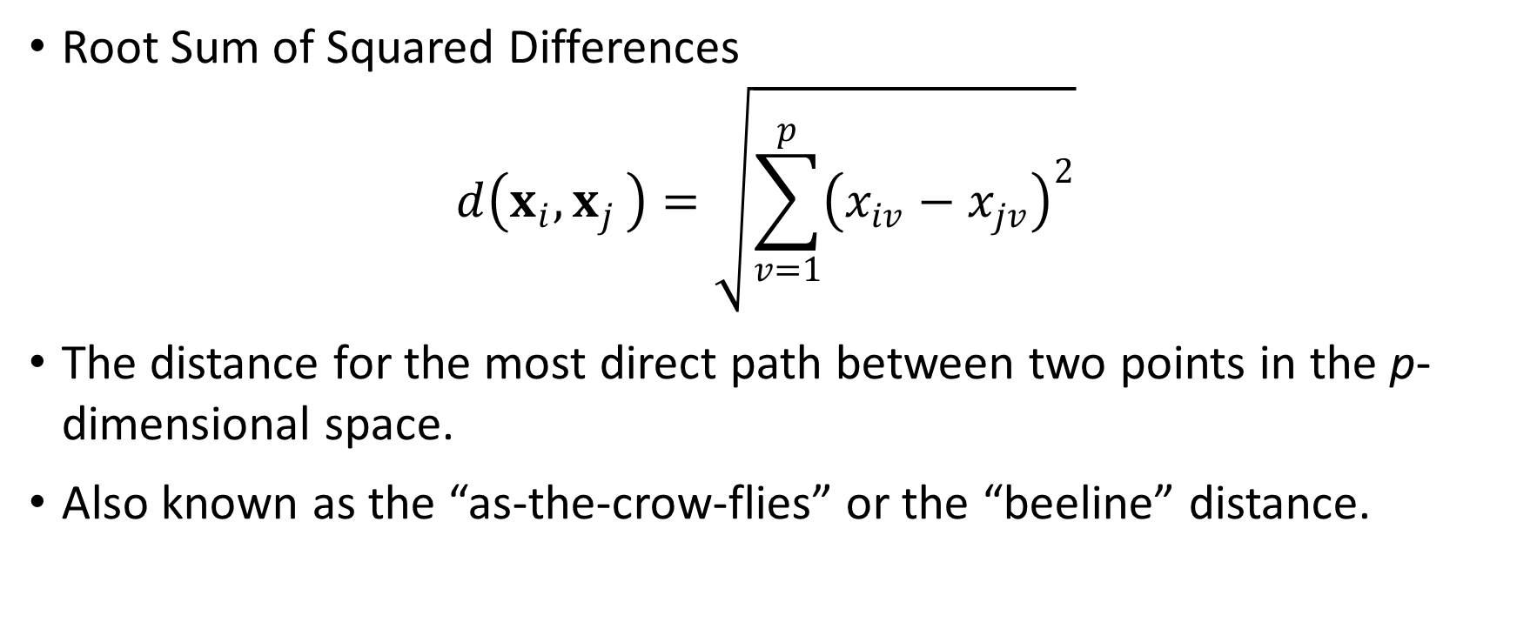
Euclidean Distance
Root Sum of Squared Differences
$$d\left(x_{i}{, x}_{j}\right)=\sqrt{\sum_{v=1}^{p}{{\left(x_{iv}−x_{jv}\right)}^{2}}}$$
The distance for the most direct path between two points in the p-dimensional space.
Also known as the “as-the-crow-flies” or the “beeline” distance.

Slide 12

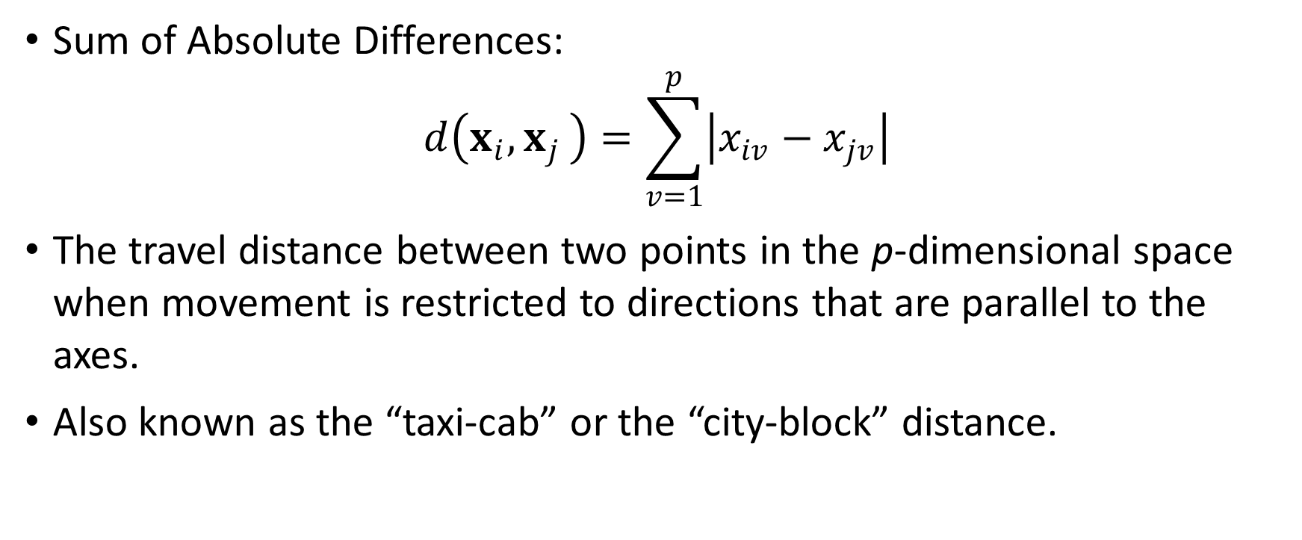
Manhattan Distance
Sum of Absolute Differences:
$$d\left(x_{i}{, x}_{j}\right)=\sum_{v=1}^{p}{\left|x_{iv}−x_{jv}\right|}$$
The travel distance between two points in the p-dimensional space when movement is restricted to directions that are parallel to the axes.
Also known as the “taxi-cab” or the “city-block” distance.

Slide 13
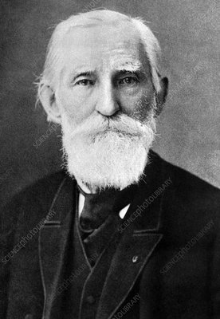
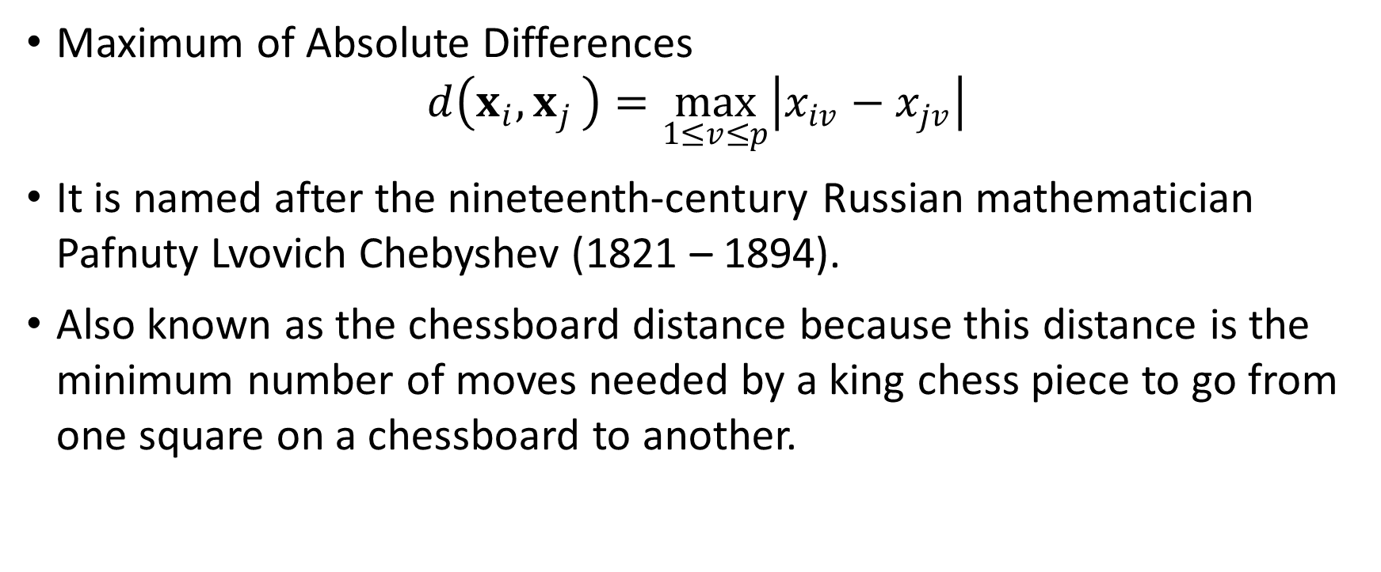
Chebyshev Distance
Maximum of Absolute Differences
$$d\left(x_{i}{, x}_{j}\right)=\max_{1≤v≤p}\left|x_{iv}−x_{jv}\right|$$
It is named after the nineteenth-century Russian mathematician Pafnuty Lvovich Chebyshev (1821 – 1894).
Also known as the chessboard distance because this distance is the minimum number of moves needed by a king chess piece to go from one square on a chessboard to another.

Slide 14
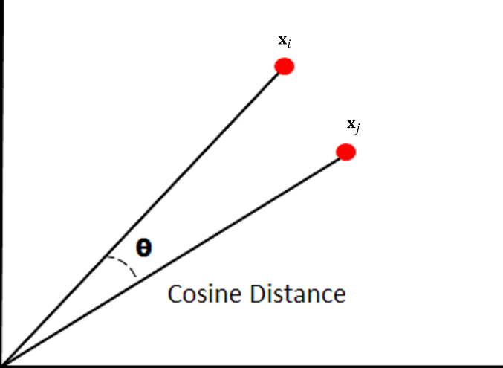
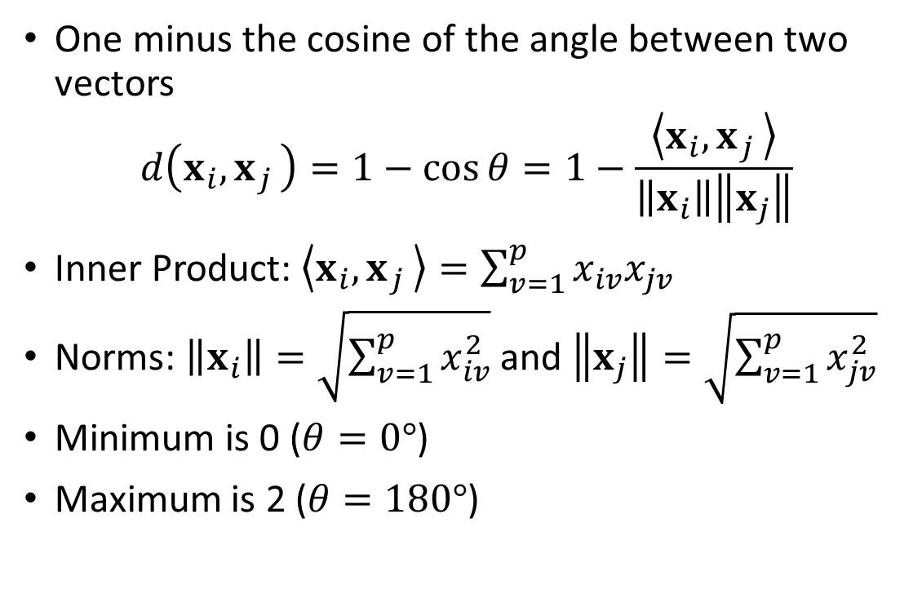
Cosine Distance
One minus the cosine of the angle between two vectors
$$d\left(x_{i}{, x}_{j}\right)=1−cos{θ}=1−\frac{\left\langle x_{i}{, x}_{j}\right\rangle }{\left\|x_{i}\right\|\left\|x_{j}\right\|}$$
Inner Product: $\left\langle x_{i}{, x}_{j}\right\rangle =\sum_{v=1}^{p}{x_{iv}x_{jv}}$
Norms: $\left\|x_{i}\right\|=\sqrt{\sum_{v=1}^{p}{x_{iv}^{2}}}$ and $\left\|x_{j}\right\|=\sqrt{\sum_{v=1}^{p}{x_{jv}^{2}}}$
Minimum is 0 ($θ=0°$)
Maximum is 2 ($θ=180°$)

Slide 15
Usage Scenarios of Distance Metrics
Euclidean Distance. Shortest distance between two points.
Manhattan Distance. More appropriate if different dimensions are not comparable (e.g., different ranges).
Chebyshev Distance. In a warehouse, the distance between locations can be represented as Chebyshev distance if an overhead crane is used because the crane moves on both axes at the same time with the same speed.
Cosine Distance. Used in text analysis to measure how different two documents are irrespective of their sizes (i.e., number of words).

Slide 16
Usage Scenario of Cosine Distance
Determine if the document contains the name of a Chinese city
 | ID | Words in Document | City in China?
Data | 1 | Chinese Beijing Chinese | Yes
 | 2 | Chinese Chinese Shanghai | Yes
 | 3 | Chinese Macao | Yes
 | 4 | Tokyo Japan Chinese | No
Probe | 5 | Chinese Chinese Chinese Tokyo Japan | ?
 | 6 | Beijing Shanghai Macao | ?

Slide 17
Cosine Distance
Create Word Count Array. There are six unique words: (1) Chinese, (2) Beijing, (3) Shanghai, (4) Macao, (5) Tokyo, and (6) Japan.
Data:
Probe:
ID | Chinese | Beijing | Shanghai | Macao | Tokyo | Japan
1 | 2 | 1 | 0 | 0 | 0 | 0
2 | 2 | 0 | 1 | 0 | 0 | 0
3 | 1 | 0 | 0 | 1 | 0 | 0
4 | 1 | 0 | 0 | 0 | 1 | 1
ID | Chinese | Beijing | Shanghai | Macao | Tokyo | Japan
5 | 3 | 0 | 0 | 0 | 1 | 1
6 | 0 | 1 | 1 | 1 | 0 | 0

Slide 18
Calculate Distances
import numpy
def CosineD (x, y):
normX = numpy.sqrt(numpy.dot(x, x))
normY = numpy.sqrt(numpy.dot(y, y))
if (normX > 0.0 and normY > 0.0):
outDistance = 1.0 - numpy.dot(x, y) / normX / normY
else:
outDistance = numpy.NaN
return (outDistance)
X = numpy.array([[2,1,0,0,0,0],
[2,0,1,0,0,0],
[1,0,0,1,0,0],
[1,0,0,0,1,1]])
P = numpy.array([[3,0,0,0,1,1],
[0,1,1,1,0,0]])
cosine_D = numpy.zeros((4,2))
for i in range(4):
for j in range(2):
cosine_D[i,j] = CosineD(X[i,:], P[j,:])
cosine_D
 | Probe
Data | 5 | 6
1 | 0.19 | 0.74
2 | 0.19 | 0.74
3 | 0.36 | 0.59
4 | 0.13 | 1.00
Probe ID #5 is closest to Data ID #4.
Probe ID #6 is closest to Data ID #3.

Slide 19
Closest Neighbor According to Cosine Distance
Probe ID #5 is closest to Data ID #4.
Probe ID #6 is closest to Data ID #3
 | ID | Words in Document | City in China?
Data | 1 | Chinese Beijing Chinese | Yes
 | 2 | Chinese Chinese Shanghai | Yes
 | 3 | Chinese Macao | Yes
 | 4 | Tokyo Japan Chinese | No
Probe | 5 | Chinese Chinese Chinese Tokyo Japan | ?
 | 6 | Beijing Shanghai Macao | ?

Slide 20
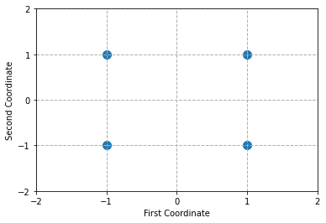
Compare Common Distance Metrics
Calculate the distances among these four points
Two-dimensional coordinates
Point Index | First Coordinate | Second Coordinate
0 | -1 | -1
1 | -1 | 1
2 | 1 | -1
3 | 1 | 1

Slide 21
Calculate Distances
import numpy
def Euclidean (x, y):
outDistance = numpy.sqrt(numpy.sum((x - y)**2))
return (outDistance)
def Manhattan (x, y):
outDistance = numpy.sum(numpy.abs(x - y))
return (outDistance)
def Chebyshev (x, y):
outDistance = numpy.max(numpy.abs(x - y))
return (outDistance)
def CosineD (x, y):
normX = numpy.sqrt(numpy.dot(x, x))
normY = numpy.sqrt(numpy.dot(y, y))
if (normX > 0.0 and normY > 0.0):
outDistance = 1.0 - numpy.dot(x, y) / normX / normY
else:
outDistance = numpy.NaN
return (outDistance)
clist = [-1.0, 1.0]
points = numpy.array([])
for u in clist:
for v in clist:
points = numpy.append(points, [u, v], axis = 0)
nPoints = len(clist) ** 2
points = numpy.reshape(points, (nPoints,2))
distance_E = numpy.zeros((nPoints,nPoints))
distance_M = numpy.zeros((nPoints,nPoints))
distance_C = numpy.zeros((nPoints,nPoints))
distance_O = numpy.zeros((nPoints,nPoints))
for i in range(nPoints):
for j in range(nPoints):
distance_E[i,j] = Euclidean(points[i,:], points[j,:])
distance_M[i,j] = Manhattan(points[i,:], points[j,:])
distance_C[i,j] = Chebyshev(points[i,:], points[j,:])
distance_O[i,j] = CosineD(points[i,:], points[j,:])

Slide 22
Four Distance Metrics
 | Euclidean Distance
 | (-1,-1) | (-1,1) | (1,-1) | (1,1)
(-1,-1) | 0 | 2 | 2 | 2.83
(-1,1) | 2 | 0 | 2.83 | 2
(1,-1) | 2 | 2.83 | 0 | 2
(1,1) | 2.83 | 2 | 2 | 0
 | Manhattan Distance
 | (-1,-1) | (-1,1) | (1,-1) | (1,1)
(-1,-1) | 0 | 2 | 2 | 4
(-1,1) | 2 | 0 | 4 | 2
(1,-1) | 2 | 4 | 0 | 2
(1,1) | 4 | 2 | 2 | 0
 | Chebyshev Distance
 | (-1,-1) | (-1,1) | (1,-1) | (1,1)
(-1,-1) | 0 | 2 | 2 | 2
(-1,1) | 2 | 0 | 2 | 2
(1,-1) | 2 | 2 | 0 | 2
(1,1) | 2 | 2 | 2 | 0
 | Cosine Distance
 | (-1,-1) | (-1,1) | (1,-1) | (1,1)
(-1,-1) | 0 | 1 | 1 | 2
(-1,1) | 1 | 0 | 2 | 1
(1,-1) | 1 | 2 | 0 | 1
(1,1) | 2 | 1 | 1 | 0

Slide 23
k-Nearest Neighbors (kNN) Algorithm
Data Preparation:
Since distance metric works only on interval predictors, dummy variables must be created for nominal or ordinal predictors first.
Example:
CAT is a nominal predictor with levels: “A”, “B”, and “C”
CAT_A = 1 if CAT = “A”, and 0 otherwise
CAT_B = 1 if CAT = “B”, and 0 otherwise
CAT_C = 1 if CAT = “C”, and 0 otherwise

Slide 24
k-Nearest Neighbors (kNN) Algorithm
Data Preparation:
Example (attributes of a person):
BMI Table: Height may vary from 4 feet 10 inches to 6 feet 4 inches
BMI Table: Weight may vary from 91 pounds to 443 pounds
Annual Income may vary from $20,000 to $500,000
Difference:
10 inches difference in height is very visible
10 pounds difference in weight may worry some but not all the people
10 dollars difference in income won’t make one person richer than the others

Slide 25
k-Nearest Neighbors (kNN) Algorithm
Optionally Scaling of Input Variables:
Perform principal component analysis to scale or transform input (excluding target) variables into orthonormal components.
Any two orthonormal components have zero correlation
All orthonormal components have the same variance
Two reasons to scale or orthonormalize the input variables
Avoid highly correlated input variables to contribute unnecessary addition to the distance metric
Avoid input variables that have relatively large absolute values to exert unwanted leverages on the results

Slide 26
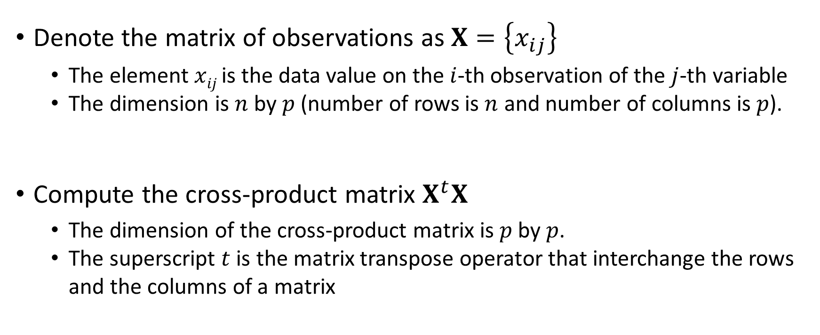
Orthonormal Transformation
Denote the matrix of observations as $X=\left\{x_{ij}\right\}$
The element $xij$ is the data value on the $i$-th observation of the $j$-th variable
The dimension is $n$ by $p$ (number of rows is $n$ and number of columns is $p$).
Compute the cross-product matrix $X^{t}X$
The dimension of the cross-product matrix is $p$ by $p$.
The superscript $t$ is the matrix transpose operator that interchange the rows and the columns of a matrix

Slide 27

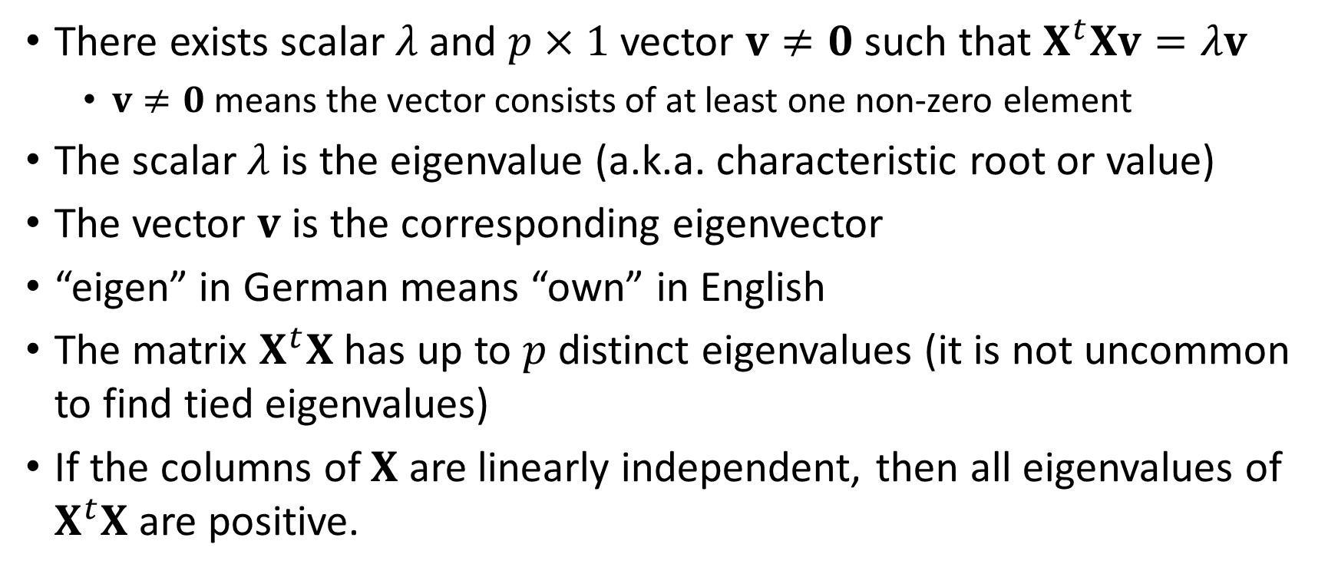
Eigenvalues and Eigenvectors of $X^{t}X$
There exists scalar $λ$ and $p×1$ vector $v≠0$ such that $X^{t}Xv=λv$
$v≠0$ means the vector consists of at least one non-zero element
The scalar $λ$is the eigenvalue (a.k.a. characteristic root or value)
The vector $v$ is the corresponding eigenvector
“eigen” in German means “own” in English
The matrix $X^{t}X$ has up to $p$ distinct eigenvalues (it is not uncommon to find tied eigenvalues)
If the columns of $X$ are linearly independent, then all eigenvalues of $X^{t}X$ are positive.

Slide 28

Proof that Eigenvalues of $X^{t}X$ are Positive
If the columns of $X$ are linearly independent, then $Xu=0$ if and only if $u = 0$. Since the eigenvector $v≠0$ then $Xv≠0$ (a linear algebra fact)
If the columns of 𝐗 are linearly independent, then 𝐗𝐮=𝟎 if and only if 𝐮 = 0. Since the eigenvector 𝐯≠0 then 𝐗𝐯≠𝟎 (a linear algebra fact)
Let $w=Xv$, then $w^{t}=v^{t}X^{t}$. Hence $w^{t}w=v^{t}X^{t}Xv=v^{t}\left(X^{t}Xv\right)=v^{t}\left(λv\right)=λv^{t}v$
Let 𝐰=𝐗𝐯, then 𝐰^𝑡=𝐯^𝑡 𝐗^𝑡. Hence 𝐰^𝑡 𝐰=𝐯^𝑡 𝐗^𝑡 𝐗𝐯=𝐯^𝑡 (𝐗^𝑡 𝐗𝐯)=𝐯^𝑡 (𝜆𝐯)=𝜆𝐯^𝑡 𝐯
$λ=\frac{w^{t}w}{v^{t}v}>0$ because $w^{t}w>0$ and $v^{t}v>0$
𝜆=(𝐰^𝑡 𝐰)/(𝐯^𝑡 𝐯)>0 because 𝐰^𝑡 𝐰>0 and 𝐯^𝑡 𝐯>𝟎

Slide 29
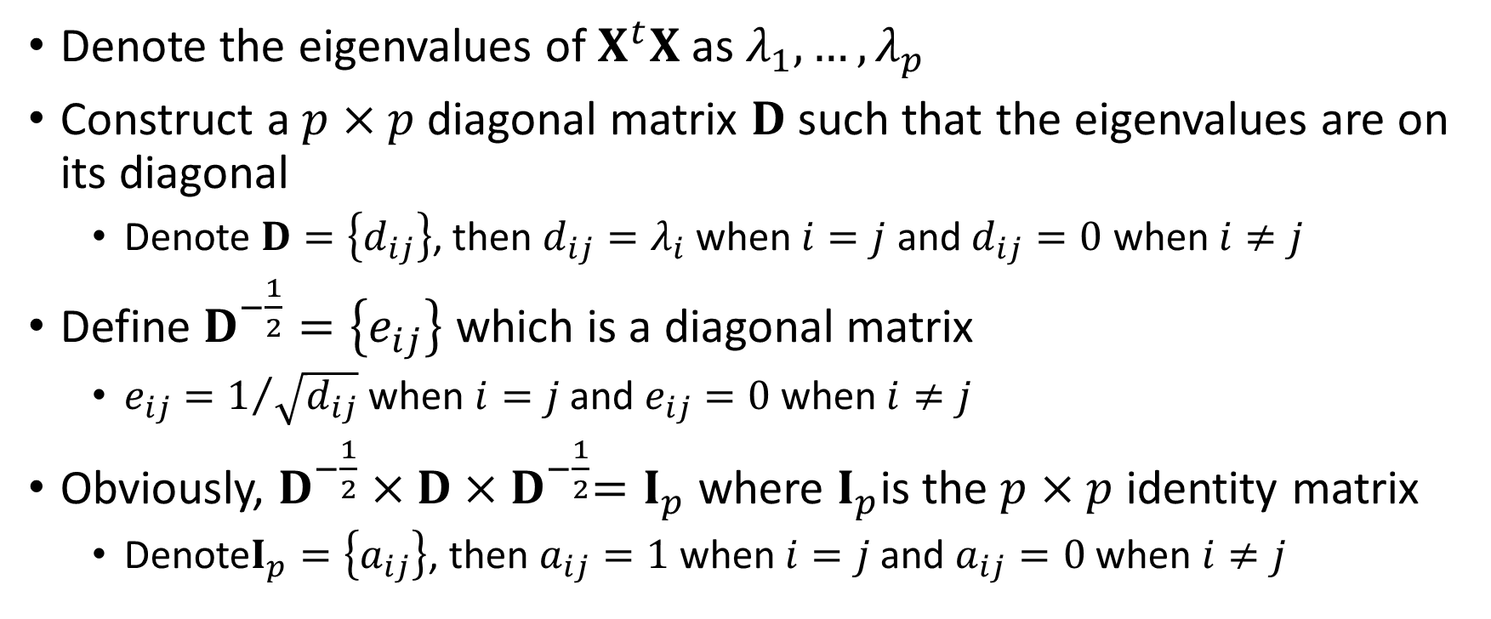
Orthonormal Transformation
Denote the eigenvalues of $X^{t}X$ as $λ_{1},…,λ_{p}$
Construct a $p×p$ diagonal matrix $D$ such that the eigenvalues are on its diagonal
Denote $D=\left\{d_{ij}\right\}$, then $d_{ij}=λ_{i}$ when $i=j$ and $d_{ij}=0$ when $i≠j$
Define $D^{−\frac{1}{2}}=\left\{e_{ij}\right\}$ which is a diagonal matrix
$e_{ij}=1/{\sqrt{d_{ij}}}$ when $i=j$ and $e_{ij}=0$ when $i≠j$
Obviously, $D^{−\frac{1}{2}}×D{×D}^{−\frac{1}{2}}=I_{p}$ where $I_{p}$is the $p×p$ identity matrix
Denote$I_{p}=\left\{a_{ij}\right\}$, then $a_{ij}=1$ when $i=j$ and $a_{ij}=0$ when $i≠j$

Slide 30
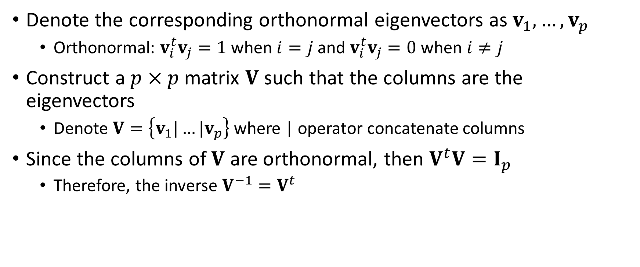
Orthonormal Transformation
Denote the corresponding orthonormal eigenvectors as $v_{1},…,v_{p}$
Orthonormal: $v_{i}^{t}v_{j}=1$ when $i=j$ and $v_{i}^{t}v_{j}=0$ when $i≠j$
Construct a $p×p$ matrix $V$ such that the columns are the eigenvectors
Denote $V=\left\{v_{1}|…|v_{p}\right\}$ where | operator concatenate columns
Since the columns of $V$ are orthonormal, then $V^{t}V=I_{p}$
Therefore, the inverse $V^{−1}=V^{t}$

Slide 31
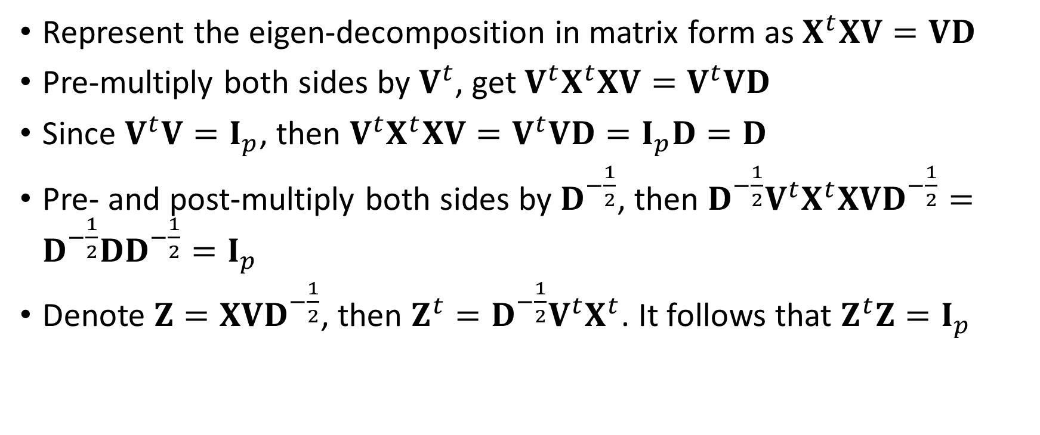
Orthonormal Transformation
Represent the eigen-decomposition in matrix form as $X^{t}XV=VD$
Pre-multiply both sides by $V^{t}$, get $V^{t}X^{t}XV=V^{t}VD$
Since $V^{t}V=I_{p}$, then $V^{t}X^{t}XV=V^{t}VD=I_{p}D=D$
Pre- and post-multiply both sides by $D^{−\frac{1}{2}}$, then ${D^{−\frac{1}{2}}V}^{t}X^{t}XVD^{−\frac{1}{2}}=D^{−\frac{1}{2}}DD^{−\frac{1}{2}}=I_{p}$
Denote $Z=XVD^{−\frac{1}{2}}$, then $Z^{t}={D^{−\frac{1}{2}}V}^{t}X^{t}$. It follows that $Z^{t}Z=I_{p}$

Slide 32
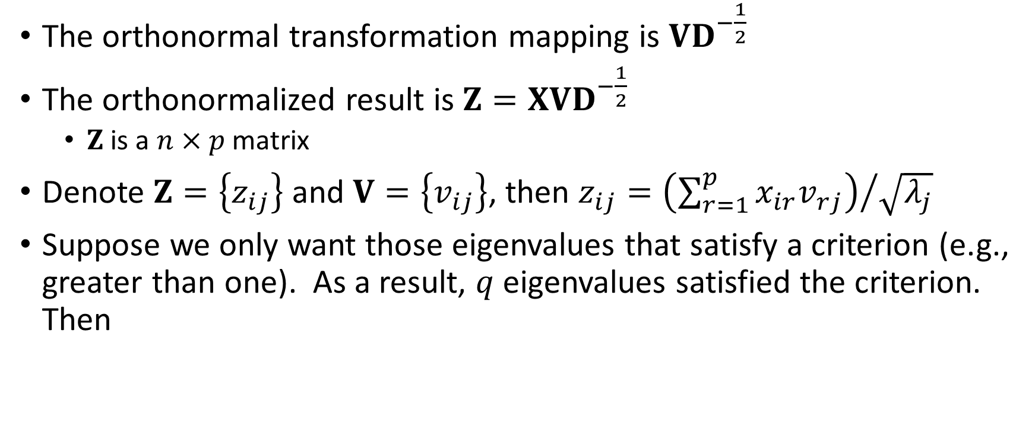
Orthonormal Transformation
The orthonormal transformation mapping is $VD^{−\frac{1}{2}}$
The orthonormalized result is $Z=XVD^{−\frac{1}{2}}$
$Z$ is a $n×p$ matrix
Denote $Z=\left\{z_{ij}\right\}$ and $V=\left\{v_{ij}\right\}$, then $z_{ij}={\left(\sum_{r=1}^{p}{x_{ir}v_{rj}}\right)}/{\sqrt{λ_{j}}}$
Suppose we only want those eigenvalues that satisfy a criterion (e.g., greater than one). As a result, $q$ eigenvalues satisfied the criterion. Then

Slide 33
Orthonormalization in Python: First Principle
Week 2 Eigenvalue.py
import numpy as np
from numpy import linalg as LA
import pandas as pd
# Input the matrix X
x = np.matrix([[5.1, 160, 82000],
[5.2, 170, 84000],
[5.3, 180, 86000],
[5.4, 190, 88000],
[5.5, 200, 90000],
[5.6, 110, 81000],
[5.7, 120, 83000],
[5.8, 130, 85000],
[5.9, 140, 87000],
[6.0, 150, 89000]])
print("Input Matrix = \n", x)
print("Number of Dimensions = ", x.ndim)
print("Number of Rows = ", np.size(x,0))
print("Number of Columns = ", np.size(x,1))
xtx = x.transpose() * x
print("t(x) * x = \n", xtx)
# Eigenvalue decomposition
evals, evecs = LA.eigh(xtx)
print("Eigenvalues of x = \n", evals)
print("Eigenvectors of x = \n",evecs)
# Here is the transformation matrix
dvals = 1.0 / numpy.sqrt(evals)
transf = evecs * numpy.diagflat(dvals)
print("Transformation Matrix = \n", transf)
# Here is the transformed X
transf_x = x * transf
print("The Transformed x = \n", transf_x)
# Check columns of transformed X
xtx = transf_x.transpose() * transf_x
print("Expect an Identity Matrix = \n", xtx)

Slide 34
Orthonormalization in Python: First Principle
Week 2 Eigenvalue.py
Input Matrix =
[[5.1e+00 1.6e+02 8.2e+04]
[5.2e+00 1.7e+02 8.4e+04]
[5.3e+00 1.8e+02 8.6e+04]
[5.4e+00 1.9e+02 8.8e+04]
[5.5e+00 2.0e+02 9.0e+04]
[5.6e+00 1.1e+02 8.1e+04]
[5.7e+00 1.2e+02 8.3e+04]
[5.8e+00 1.3e+02 8.5e+04]
[5.9e+00 1.4e+02 8.7e+04]
[6.0e+00 1.5e+02 8.9e+04]]
Number of Dimensions = 2
Number of Rows = 10
Number of Columns = 3
t(x) * x =
[[3.0885e+02 8.5600e+03 4.7480e+06]
[8.5600e+03 2.4850e+05 1.3305e+08]
[4.7480e+06 1.3305e+08 7.3185e+10]]
Eigenvalues of x =
[3.53398246e-02 6.61645828e+03 7.31852422e+10]
Eigenvectors of x =
[[ 9.99941038e-01 1.08589624e-02 -6.48765732e-05]
[ 1.08588266e-02 -9.99939389e-01 -1.81799265e-03]
[-8.46141548e-05 1.81718097e-03 -9.99998345e-01]]
Transformation Matrix =
[[ 5.31914960e+00 1.33498241e-04 -2.39814890e-10]
[ 5.77631289e-02 -1.22930851e-02 -6.72017163e-09]
[-4.50101887e-04 2.23401143e-05 -3.69647288e-06]]
The Transformed x =
[[-0.53859115 -0.1343234 -0.30311185]
[-0.32924867 -0.21256067 -0.31050487]
[-0.1199062 -0.29079794 -0.31789788]
[ 0.08943628 -0.36903521 -0.32529089]
[ 0.29877875 -0.44727248 -0.3326839 ]
[-0.31707091 0.45805749 -0.29941504]
[-0.10772844 0.37982022 -0.30680806]
[ 0.10161404 0.30158295 -0.31420107]
[ 0.31095651 0.22334568 -0.32159408]
[ 0.52029899 0.1451084 -0.3289871 ]]
Expect an Identity Matrix =
[[ 9.99999987e-01 2.77018366e-09 -5.73498741e-13]
[ 2.77018366e-09 9.99999999e-01 2.81749885e-13]
[-5.73498741e-13 2.81749885e-13 1.00000000e+00]]
(XVD^{-1/2})^{t}(XVD^{-1/2}) = I

Slide 35
Orthonormalization in Python: SciPy Function
Week 2 Eigenvalue.py
import numpy as np
from numpy import linalg as LA
import pandas as pd
# Input the matrix X
x = np.matrix([[5.1, 160, 82000],
[5.2, 170, 84000],
[5.3, 180, 86000],
[5.4, 190, 88000],
[5.5, 200, 90000],
[5.6, 110, 81000],
[5.7, 120, 83000],
[5.8, 130, 85000],
[5.9, 140, 87000],
[6.0, 150, 89000]])
# Orthonormalize using the orth function
import scipy
from scipy import linalg as LA2
orthx = LA2.orth(x)
print("The orthonormalize x = \n", orthx)
# Check columns of the ORTH function
check = orthx.transpose().dot(orthx)
print("Also Expect an Identity Matrix = \n", check)

Slide 36
Comparison
First Principles
The Transformed x =
[[-0.53859114 -0.1343234 -0.30311185]
[-0.32924867 -0.21256067 -0.31050487]
[-0.1199062 -0.29079794 -0.31789788]
[ 0.08943627 -0.36903521 -0.32529089]
[ 0.29877874 -0.44727248 -0.3326839 ]
[-0.3170709 0.45805749 -0.29941504]
[-0.10772843 0.37982022 -0.30680806]
[ 0.10161404 0.30158295 -0.31420107]
[ 0.31095651 0.22334568 -0.32159408]
[ 0.52029898 0.1451084 -0.3289871 ]]
Expect an Identity Matrix =
[[ 9.99999953e-01 1.00405564e-08 -2.52808885e-12]
[ 1.00405564e-08 9.99999998e-01 1.23873134e-13]
[-2.52808885e-12 1.23873134e-13 1.00000000e+00]]
SciPy orth() Function
The orthonormalize x =
[[-0.30311185 0.1343234 0.53859115]
[-0.31050487 0.21256067 0.32924868]
[-0.31789788 0.29079794 0.1199062 ]
[-0.32529089 0.36903521 -0.08943628]
[-0.3326839 0.44727248 -0.29877875]
[-0.29941504 -0.45805749 0.31707091]
[-0.30680806 -0.37982022 0.10772844]
[-0.31420107 -0.30158295 -0.10161404]
[-0.32159408 -0.22334568 -0.31095652]
[-0.3289871 -0.1451084 -0.52029899]]
Also Expect an Identity Matrix =
[[ 1.00000000e+00 2.77555756e-17 1.11022302e-16]
[ 2.77555756e-17 1.00000000e+00 -1.11022302e-16]
[ 1.11022302e-16 -1.11022302e-16 1.00000000e+00]]
Switched Sign
Week 2 Eigenvalue.py

Slide 37
Orthonormal Transformation
Suppose we only want those eigenvalues that satisfy a criterion (e.g., greater than one).
As a result, $q$ eigenvalues satisfied the criterion.
As a result, 𝑞 eigenvalues satisfied the criterion.
The matrix $V$ consists of the corresponding $q$ eigenvectors
The matrix 𝐕 consists of the corresponding 𝑞 eigenvectors
Finally, $Z$ would be a $n×q$ matrix instead
Finally, 𝑍 would be a 𝑛×𝑞 matrix instead

Slide 38
Want Eigenvalues that are Greater than One
Week 2 Eigenvalue Special.py
import numpy as np
from numpy import linalg as LA
import pandas as pd
# Input the matrix X
x = np.matrix([[5.1, 160, 82000],
[5.2, 170, 84000],
[5.3, 180, 86000],
[5.4, 190, 88000],
[5.5, 200, 90000],
[5.6, 110, 81000],
[5.7, 120, 83000],
[5.8, 130, 85000],
[5.9, 140, 87000],
[6.0, 150, 89000]])
print("Input Matrix = \n", x)
print("Number of Dimensions = ", x.ndim)
print("Number of Rows = ", np.size(x,0))
print("Number of Columns = ", np.size(x,1))
xtx = x.transpose() * x
print("t(x) * x = \n", xtx)
# Eigenvalue decomposition
evals, evecs = LA.eigh(xtx)
print("Eigenvalues of x = \n", evals)
print("Eigenvectors of x = \n",evecs)
# Want eigenvalues greater than one
evals_1 = evals[evals > 1.0]
evecs_1 = evecs[:,evals > 1.0]
# Here is the transformation matrix
dvals = 1.0 / numpy.sqrt(evals_1)
transf = evecs_1 * numpy.diagflat(dvals)
print("Transformation Matrix = \n", transf)
# Here is the transformed X
transf_x = x * transf;
print("The Transformed x = \n", transf_x)
# Check columns of transformed X
xtx = transf_x.transpose() * transf_x;
print("Expect an Identity Matrix = \n", xtx)

Slide 39
Orthonormalization in Python: First Principle
Week 2 Eigenvalue Special.py
Input Matrix =
[[5.1e+00 1.6e+02 8.2e+04]
[5.2e+00 1.7e+02 8.4e+04]
[5.3e+00 1.8e+02 8.6e+04]
[5.4e+00 1.9e+02 8.8e+04]
[5.5e+00 2.0e+02 9.0e+04]
[5.6e+00 1.1e+02 8.1e+04]
[5.7e+00 1.2e+02 8.3e+04]
[5.8e+00 1.3e+02 8.5e+04]
[5.9e+00 1.4e+02 8.7e+04]
[6.0e+00 1.5e+02 8.9e+04]]
Number of Dimensions = 2
Number of Rows = 10
Number of Columns = 3
t(x) * x =
[[3.0885e+02 8.5600e+03 4.7480e+06]
[8.5600e+03 2.4850e+05 1.3305e+08]
[4.7480e+06 1.3305e+08 7.3185e+10]]
Eigenvalues of x =
[3.53398234e-02 6.61645827e+03 7.31852422e+10]
Eigenvectors of x =
[[ 9.99941038e-01 1.08589624e-02 -6.48765732e-05]
[ 1.08588266e-02 -9.99939389e-01 -1.81799265e-03]
[-8.46141549e-05 1.81718097e-03 -9.99998345e-01]]
Transformation Matrix =
[[ 1.33498241e-04 -2.39814890e-10]
[-1.22930851e-02 -6.72017163e-09]
[ 2.23401143e-05 -3.69647288e-06]]
The Transformed x =
[[-0.1343234 -0.30311185]
[-0.21256067 -0.31050487]
[-0.29079794 -0.31789788]
[-0.36903521 -0.32529089]
[-0.44727248 -0.3326839 ]
[ 0.45805749 -0.29941504]
[ 0.37982022 -0.30680806]
[ 0.30158295 -0.31420107]
[ 0.22334568 -0.32159408]
[ 0.1451084 -0.3289871 ]]
Expect an Identity Matrix =
[[9.99999999e-01 2.81722129e-13]
[2.81722129e-13 1.00000000e+00]]
Did you spot any differences when compared with previous results?
(XVD^{-1/2})^{t}(XVD^{-1/2}) = I

Slide 40

Pop Quiz 1
Online on Blackboard
One question
Two bonus points
Make up to two attempts
Take the highest score
Answer before 12:00 Noon on January 29, 2021

Slide 41
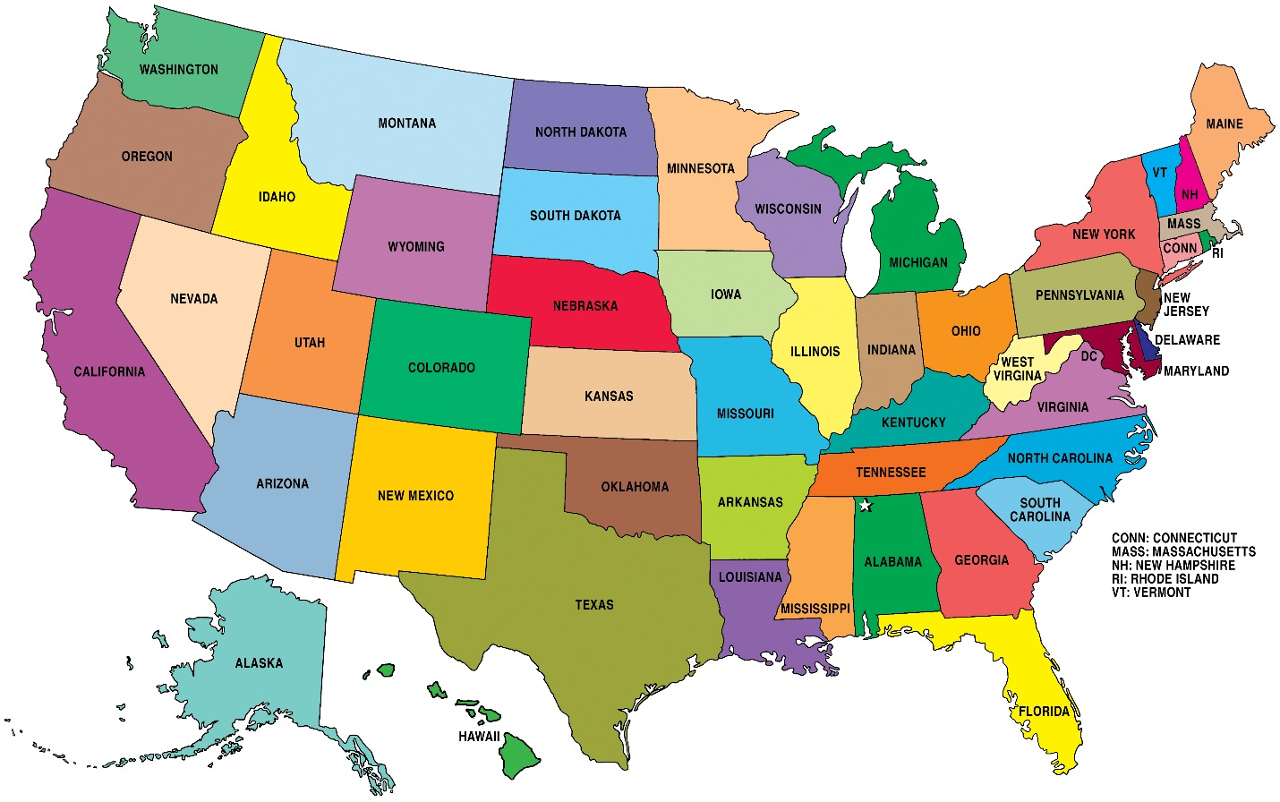
Number of Neighbors
The k value must be an integer greater than zero
The choice can be subjective
If k is too small (say 1), then the results are either sensitive to noise observations or biased.
If k is too large (say 50), then the neighborhood may include observations which may cause more distraction than adding information.

Slide 42
Determine the Number of Neighbors
Has Target Variable
Adjust the number of neighbors until the classifications (or predictions) are more “consistent” with the observed target value(s)
No Target Variable
I am not aware of the answer when there is no target variable
Use your best analytical judgment!
Consistency is defined in terms of lower misclassification or prediction error

Slide 43
Number of Neighbors
Grid Search for the Number of Neighbors:
Select a range of integers, say 1 ≤ k ≤ 20
Choose the lower bound based on your idea of the minimum number of neighbors to make up a community
Choose the upper bound according to your ability to comprehend that many numbers of neighbors
Run the Nearest Neighbors algorithm for each value of k and obtain predicted values of the target variable
Select your value of k such that the predicted values most “match” the observed values of the target variable

Slide 44
Classification or Prediction
Classification:
Target is categorical
Probabilities of the categories from the neighbors are calculated
The category with the highest probability is the predicted target value
Prediction:
Target is of interval type
Mean or median of the neighbors is the predicted target value

Slide 45

Toy Example
CaseID | x1 | x2 | y
1 | 7.7 | -37 | 4
2 | 9.5 | -38 | 1
3 | 3 | -34 | 2
4 | 9.1 | -75 | 1
5 | 2.2 | -31 | 2
6 | 4.8 | -7 | 4
7 | 5.5 | -6 | 3
8 | 10 | -61 | 1
9 | 4.2 | -23 | 2
10 | 1.6 | -54 | 1
Two input variables: x1 and x2
One target: y
Ten observations
Euclidean distance between first two cases:
SQRT((7.7 – 9.5)² + ((-37) – (-38))²) = SQRT(4.24) = 2.0591 (up to 4 decimal places)
SQRT(x) = $\sqrt{x}$

Slide 46
Toy Example
Euclidean Distance Matrix:
 | CaseID
CaseID | 1 | 2 | 3 | 4 | 5 | 6 | 7 | 8 | 9 | 10
1 | 0 | 2.0591 | 5.5758 | 38.0258 | 8.1394 | 30.1398 | 31.0780 | 24.1100 | 14.4309 | 18.0613
2 | 2.0591 | 0 | 7.6322 | 37.0022 | 10.1139 | 31.3543 | 32.2490 | 23.0054 | 15.9088 | 17.8440
3 | 5.5758 | 7.6322 | 0 | 41.4513 | 3.1048 | 27.0599 | 28.1114 | 27.8927 | 11.0653 | 20.0489
4 | 38.0258 | 37.0022 | 41.4513 | 0 | 44.5377 | 68.1358 | 69.0938 | 14.0289 | 52.2304 | 22.2991
5 | 8.1394 | 10.1139 | 3.1048 | 44.5377 | 0 | 24.1404 | 25.2169 | 30.9974 | 8.2462 | 23.0078
6 | 30.1398 | 31.3543 | 27.0599 | 68.1358 | 24.1404 | 0 | 1.2207 | 54.2498 | 16.0112 | 47.1088
7 | 31.0780 | 32.2490 | 28.1114 | 69.0938 | 25.2169 | 1.2207 | 0 | 55.1838 | 17.0496 | 48.1582
8 | 24.1100 | 23.0054 | 27.8927 | 14.0289 | 30.9974 | 54.2498 | 55.1838 | 0 | 38.4401 | 10.9343
9 | 14.4309 | 15.9088 | 11.0653 | 52.2304 | 8.2462 | 16.0112 | 17.0496 | 38.4401 | 0 | 31.1088
10 | 18.0613 | 17.8440 | 20.0489 | 22.2991 | 23.0078 | 47.1088 | 48.1582 | 10.9343 | 31.1088 | 0

Slide 47
Toy Example
Rank the Euclidean distances:
1 = the most nearest neighbor which is yourself
10 = the least nearest (i.e., most distant) neighbor
 | CaseID
CaseID | 1 | 2 | 3 | 4 | 5 | 6 | 7 | 8 | 9 | 10
1 | 0 | 2.0591 | 5.5758 | 38.0258 | 8.1394 | 30.1398 | 31.0780 | 24.1100 | 14.4309 | 18.0613
Rank | 1 | 2 | 3 | 10 | 4 | 8 | 9 | 7 | 5 | 6

Slide 48
Toy Example
Rank of Euclidean Distance Matrix:
 | CaseID
CaseID | 1 | 2 | 3 | 4 | 5 | 6 | 7 | 8 | 9 | 10
1 | 1 | 2 | 3 | 10 | 4 | 8 | 9 | 7 | 5 | 6
2 | 2 | 1 | 3 | 10 | 4 | 8 | 9 | 7 | 5 | 6
3 | 3 | 4 | 1 | 10 | 2 | 7 | 9 | 8 | 5 | 6
4 | 5 | 4 | 6 | 1 | 7 | 9 | 10 | 2 | 8 | 3
5 | 3 | 5 | 2 | 10 | 1 | 7 | 8 | 9 | 4 | 6
6 | 6 | 7 | 5 | 10 | 4 | 1 | 2 | 9 | 3 | 8
7 | 6 | 7 | 5 | 10 | 4 | 2 | 1 | 9 | 3 | 8
8 | 5 | 4 | 6 | 3 | 7 | 9 | 10 | 1 | 8 | 2
9 | 4 | 5 | 3 | 10 | 2 | 6 | 7 | 9 | 1 | 8
10 | 4 | 3 | 5 | 6 | 7 | 9 | 10 | 2 | 8 | 1

Slide 49
Toy Example
Find neighbors of CaseID = 1
k = 1: # 1
k = 2: # 1, 2
k = 3: # 1, 2, 3
k = 4: # 1, 2, 3, 5
k = 5: # 1, 2, 3, 5, 9
k = 6: # 1, 2, 3, 5, 9, 10
k = 7: # 1, 2, 3, 5, 9, 10, 8
k = 8: # 1, 2, 3, 5, 9, 10, 8, 6
k = 9: # 1, 2, 3, 5, 9, 10, 8, 6, 7
k = 10: # 1, 2, 3, 5, 9, 10, 8, 6, 7, 4
 | CaseID
CaseID | 1 | 2 | 3 | 4 | 5 | 6 | 7 | 8 | 9 | 10
1 | 0 | 2.0591 | 5.5758 | 38.0258 | 8.1394 | 30.1398 | 31.0780 | 24.1100 | 14.4309 | 18.0613
Rank | 1 | 2 | 3 | 10 | 4 | 8 | 9 | 7 | 5 | 6

Slide 50
Toy Example
CaseID | x1 | x2 | y
1 | 7.7 | -37 | 4
2 | 9.5 | -38 | 1
3 | 3 | -34 | 2
4 | 9.1 | -75 | 1
5 | 2.2 | -31 | 2
6 | 4.8 | -7 | 4
7 | 5.5 | -6 | 3
8 | 10 | -61 | 1
9 | 4.2 | -23 | 2
10 | 1.6 | -54 | 1
Predicted Value of CaseID = 1
k = 5: # 1, 2, 3, 5, 9
Observed y: 4, 1, 2, 2, 2
Predicted y as mean of values: = (4 + 1 + 2 + 2 + 2) / 5 = 2.2
 | CaseID
CaseID | 1 | 2 | 3 | 4 | 5 | 6 | 7 | 8 | 9 | 10
1 | 0 | 2.0591 | 5.5758 | 38.0258 | 8.1394 | 30.1398 | 31.0780 | 24.1100 | 14.4309 | 18.0613
Rank | 1 | 2 | 3 | 10 | 4 | 8 | 9 | 7 | 5 | 6

Slide 51
Toy Example
Predicted Value of CaseID = 1
CaseID | y | k | Prediction | Error
1 | 4 | 1 | 4 | 0
1 | 4 | 2 | 2.5 | 1.5
1 | 4 | 3 | 2.3333 | 1.6667
1 | 4 | 4 | 2.25 | 1.75
1 | 4 | 5 | 2.2 | 1.8
1 | 4 | 6 | 2 | 2
1 | 4 | 7 | 1.8571 | 2.1429
1 | 4 | 8 | 2.125 | 1.875
1 | 4 | 9 | 2.2222 | 1.7778
1 | 4 | 10 | 2.1 | 1.9

Slide 52
Supervised, Original Scale
Week 2 Toy Example Prediction.py
import numpy
import pandas
from sklearn.neighbors import KNeighborsRegressor
toy_example = pandas.read_csv("C:\\IIT\\Machine Learning\\Data\\Week 2 Toy Example.csv", header = 0)
# Specify the data
X = toy_example[['x1', 'x2']]
y = toy_example['y']
# Build nearest neighbors
kNNSpec = KNeighborsRegressor(n_neighbors = 2, metric = 'euclidean')
nbrs = kNNSpec.fit(X, y)
distances, indices = nbrs.kneighbors(X)
# Calculate prediction, errors, and sum of squared error
pred_y = nbrs.predict(X)
error_y = y - pred_y
sse_y = numpy.sum(error_y ** 2)

Slide 53
Specifications for Nearest Neighbors
The distance metric is Euclidean
For more distance metrics, see https://scikit-learn.org/stable/modules/generated/sklearn.neighbors.DistanceMetric.html#sklearn.neighbors.DistanceMetric
The algorithm is brute (i.e., calculate the distance between each possible pair of observations)
Other algorithms are KD-TREE and BALL-TREE. These algorithms may avoid calculating distances by storing similar observations together
KD-TREE: Bentley, J. L. (1975). Multidimensional Binary Search Trees Used for Associate Searching, Communications of the ACM, v.18, n.9, pp.509-517.
BALL-TREE: Omohundro (1989). Five Balltree Construction Algorithms, International Computer Science Institute Technical Report.

Slide 54
Supervised, Original Scale, k = 2 Solution
Index | CaseID | distances
 |  | Neighbor
 |  | 1 | 2
0 | 1 | 0.0 | 2.1
1 | 2 | 0.0 | 2.1
2 | 3 | 0.0 | 3.1
3 | 4 | 0.0 | 14.0
4 | 5 | 0.0 | 3.1
5 | 6 | 0.0 | 1.2
6 | 7 | 0.0 | 1.2
7 | 8 | 0.0 | 10.9
8 | 9 | 0.0 | 8.2
9 | 10 | 0.0 | 10.9
indices
Neighbor
1 | 2
0 | 1
1 | 0
2 | 4
3 | 7
4 | 2
5 | 6
6 | 5
7 | 9
8 | 4
9 | 7
y
Neighbor
1 | 2
4 | 1
1 | 4
2 | 2
1 | 1
2 | 2
4 | 3
3 | 4
1 | 1
2 | 2
1 | 1
pred_y | error_y
2.5 | 1.5
2.5 | -1.5
2.0 | 0
1.0 | 0
2.0 | 0
3.5 | 0.5
3.5 | -0.5
1.0 | 0
2.0 | 0
1.0 | 0
Sum of Squared Error: SSE_y = 5.0
Week 2 Nearest Neighbors Unsupervised.py

Slide 55

Supervised, Original Scale, Optimal $k$
Week 2 Nearest Neighbors Unsupervised.py
# Find optimal number of neighbors
result = pandas.DataFrame()
for k in range(10):
kNNSpec = KNeighborsRegressor(n_neighbors = (k+1), metric = 'euclidean')
nbrs = kNNSpec.fit(X, y)
pred_y = nbrs.predict(X)
error_y = y - pred_y
sse_y = numpy.sum(error_y ** 2)
result = result.append([[(k+1), sse_y]], ignore_index = True)
result = result.rename(columns = {0: 'Number of Neighbors', 1: 'Sum of Squared Error'})
plt.scatter(result['Number of Neighbors'], result['Sum of Squared Error'])
plt.xlabel('Number of Neighbors')
plt.ylabel('Sum of Squared Error')
plt.xticks(numpy.arange(1,11,1))
plt.grid(axis = 'both')
plt.show()

Slide 56
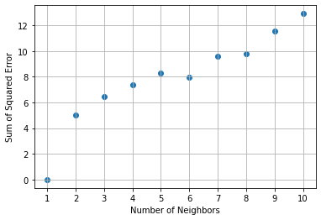
Supervised, Original Scale, Optimal $k$
When k = 1, the sum of squared error is zero. But is this a trivial solution?
The next smallest sum of squared error occurs when k = 2.
Therefore, we choose k = 2 as the optimal solution.
Week 2 Nearest Neighbors Unsupervised.py

Slide 57
Another Example: 2004 Automobile Data
Input data is Cars.csv.
Feature Variables:
Invoice: Invoice price in 2004 ($9,875 – $173,560)
Horsepower: Number of horsepower units (73 – 500 hp)
Weight: Curb Weight (1,850 – 7,190 pounds)
Identification Variable:
CaseID: Make and Row Index (e.g., Porsche_335)
Number of Neighbors:
K = 4

Slide 58
Unsupervised, Original Scale
Week 2 Nearest Neighbors Unsupervised.py
cars = pandas.read_csv('C:\\IIT\\Machine Learning\\Data\\cars.csv',delimiter=',')
cars["CaseID"] = cars["Make"] + "_" + cars.index.values.astype(str)
cars_wIndex = cars.set_index("CaseID")
# Specify the kNN
kNNSpec = kNN(n_neighbors = 4, algorithm = 'brute', metric = 'euclidean')
# Specify the training data
trainData = cars_wIndex[['Invoice', 'Horsepower', 'Weight']]
# Build nearest neighbors
nbrs = kNNSpec.fit(trainData)
distances, indices = nbrs.kneighbors(trainData)

Slide 59
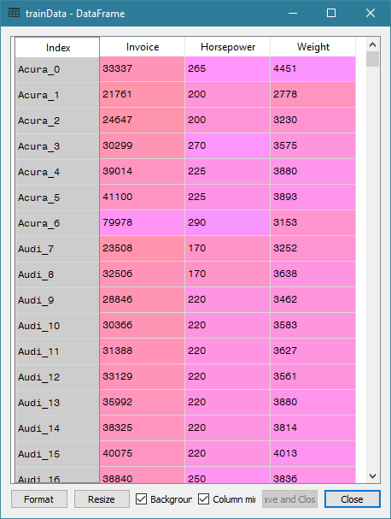
Training Data

Slide 60
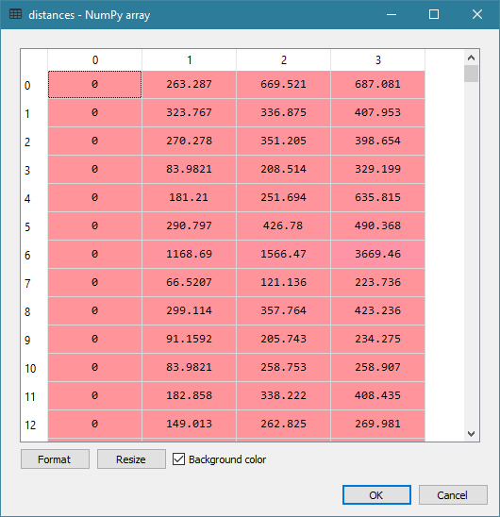
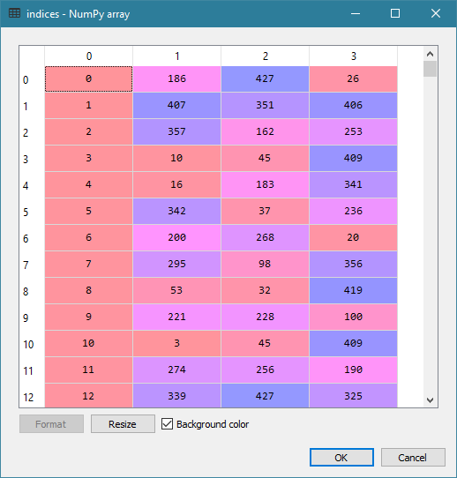
Distances and Indices

Slide 61
Find Neighbors
# Find the nearest neighbors of these focal observations
focal = [[173560, 477, 3131], # 334: Porsche 911 GT2 2dr
[119600, 493, 4473], # 262: Mercedes-Benz CL600 2dr
[117854, 493, 4429], # 271: Mercedes-Benz SL600 convertible 2dr
[113388, 493, 4235]] # 270: Mercedes-Benz SL55 AMG 2dr
myNeighbors = nbrs.kneighbors(focal, return_distance = False)
print("My Neighbors = \n", myNeighbors)
My Neighbors =
[[334 262 271 270] 261: Mercedes-Benz CL500 2dr [88324, 302, 4085]
[262 271 270 261]
[271 262 270 261]
[270 271 262 261]]

Slide 62
Unsupervised, Orthonormalized
# Orthonormalized the training data
x = numpy.matrix(trainData.values)
xtx = x.transpose() * x
print("t(x) * x = \n", xtx)
# Eigenvalue decomposition
evals, evecs = numpy.linalg.eigh(xtx)
print("Eigenvalues of x = \n", evals)
print("Eigenvectors of x = \n",evecs)
# Here is the transformation matrix
dvals = 1.0 / numpy.sqrt(evals)
transf = evecs * numpy.diagflat(dvals)
print("Transformation Matrix = \n", transf)
# Here is the transformed X
transf_x = x * transf;
print("The Transformed x = \n", transf_x)
# Check columns of transformed X
xtx = transf_x.transpose() * transf_x;
print("Expect an Identity Matrix = \n", xtx)
nbrs = kNNSpec.fit(transf_x)
distances, indices = nbrs.kneighbors(transf_x)

Slide 63
Orthonormalization
t(x) * x =
[[518478936590 3219102117 48492493679]
[ 3219102117 22151103 345284887]
[ 48492493679 345284887 5725124540]]
Eigenvalues of x =
[5.21119307e+05 1.18095293e+09 5.23044738e+11]
Eigenvectors of x =
[[ 0.00272996 -0.09349631 -0.99561588]
[-0.99930601 0.03673123 -0.00618944]
[ 0.03714888 0.99494184 -0.09333115]]
Transformation Matrix =
[[ 3.78170771e-06 -2.72068445e-06 -1.37664638e-06]
[-1.38429904e-03 1.06885585e-06 -8.55818530e-09]
[ 5.14608751e-05 2.89521886e-05 -1.29049758e-07]]
The Transformed x =
[[-0.0117161 0.03844998 -0.04646993]
[-0.05160776 0.02143814 -0.03031741]
[-0.01743343 0.02667263 -0.03434875]
...
[-0.02200692 -0.0097789 -0.05908168]
[ 0.00307681 0.0148444 -0.03428758]
[ 0.03402063 0.02081924 -0.04607865]]
Expect an Identity Matrix =
[[ 1.00000000e+00 -1.10824544e-13 -3.82333054e-14]
[-1.10824544e-13 1.00000000e+00 -4.37150316e-16]
[-3.82333054e-14 -4.37150316e-16 1.00000000e+00]]

Slide 64
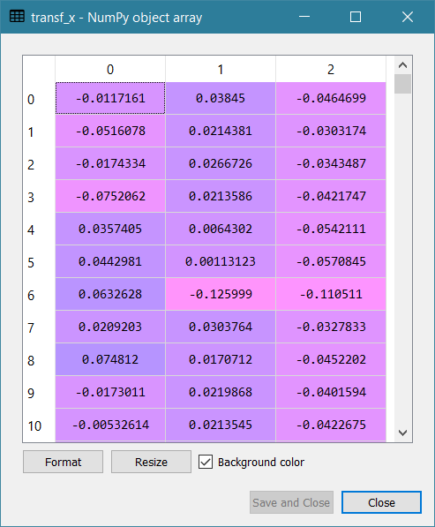
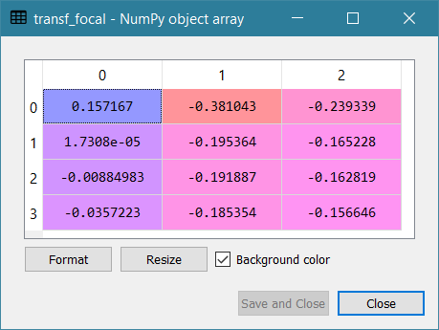
Orthonormalized Training / Focal Data

Slide 65
Find Neighbors After Orthonormalization
focal = [[173560, 477, 3131], # 334: Porsche 911 GT2 2dr
[119600, 493, 4473], # 262: Mercedes-Benz CL600 2dr
[117854, 493, 4429], # 271: Mercedes-Benz SL600 convertible 2dr
[113388, 493, 4235]] # 270: Mercedes-Benz SL55 AMG 2dr
transf_focal = focal * transf;
myNeighbors_t = nbrs.kneighbors(transf_focal, return_distance = False)
print("My Neighbors = \n", myNeighbors_t)
My Neighbors =
[[334 262 271 261]
[262 271 270 6] # 6 - Acura NSX coupe 2dr manual S [ 79978, 290, 3153]
[271 262 270 332] # 332 - Porsche 911 Carrera 4S coupe 2dr (convert) [72206, 315, 3240]
[270 271 262 200]] # 200 - Jaguar XKR convertible 2dr [79226, 390, 4042]

Slide 66
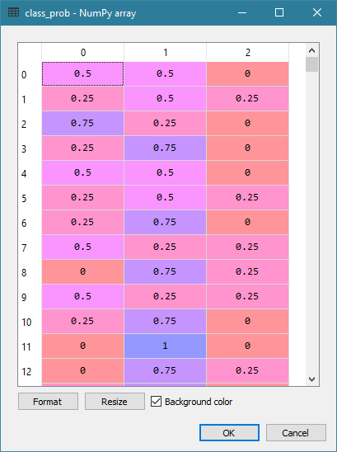
Supervised Classification
Week 2 Nearest Neighbors Supervised.py
from sklearn.neighbors import KNeighborsClassifier
# Specify target: 0 = Asia, 1 = Europe, 2 = USA
target = cars['Origin']
neigh = KNeighborsClassifier(n_neighbors=4,
algorithm = 'brute', metric = 'euclidean')
nbrs = neigh.fit(trainData, target)
# See the classification probabilities
class_prob = nbrs.predict_proba(trainData)
print(class_prob)

Slide 67
Misclassification Rate
# Calculate the Misclassification Rate
targetClass = ['Asia', 'Europe', 'USA']
nMissClass = 0
for i in range(cars_wIndex.shape[0]):
j = numpy.argmax(class_prob[i][:])
predictClass = targetClass[j]
if (predictClass != target.iloc[i]):
nMissClass += 1
rateMissClass = nMissClass / cars_wIndex.shape[0]
print('Misclassification Rate = ', rateMissClass)
Misclassification Rate = 0.32009345794392524

Slide 68
Python SKLEARN Nearest Neighbors
http://scikit-learn.org/stable/modules/neighbors.html#unsupervised-neighbors
Pros
Produces results that are readily understandable.
Works efficiently on almost any number of variables.
Offers three algorithms for storing the training data.
Cons
Cannot handle training data with nominal and interval features.
Returns NaN distance for some feature (e.g., try adding the Cylinders)
Does not suggest an optimal number of neighbors

Slide 69
Assignment 1
Open CS484_IML_Assignment_1.docx
Due at 11:59 PM on Sunday, February 7, 2021.
You must submit your answers as a PDF file.
You must also submit your Python codes as .py files
You can attempt to submit your answers no more than two times.
Only the most recently submitted answers will be graded.

Slide 70
Preparation For Week 3
Complete Assignment 1
Read Chapter 3 of the Machine Learning book if you have the book.
Ask yourself:
Why do you need to read this chapter?
What problems can I apply the algorithms in this chapter?

